Slide 1
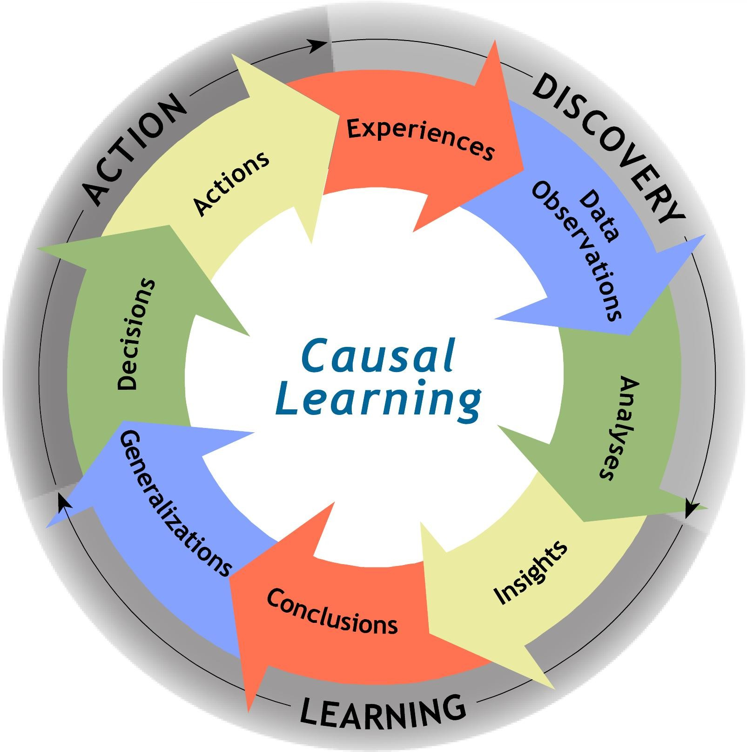

Reasoning Orientations
Notes:
Open this presentation in ‘Slideshow’ mode to hear the voiceover. It will play automatically like a video.
Hi, and welcome to Reasoning Orientations
In the next few slides, we are going to do something that we rarely set aside time to do… we are going to think about how we think
Why do we do this? Because different people can receive the same data about a problem or incident and make different meaning from it. How does that happen, you might ask… well the different meanings come from processing the same data through differing reasoning orientations.
If we take the time to understand each reasoning orientation and what it creates, then we can begin to understand when to use each, and maybe more importantly, we can begin to make common meaning of the data.
Let’s get started, shall we?

Slide 2

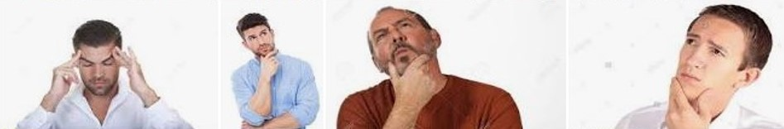
What is reasoning?
Reasoning: the process of thinking about something in a logical way in order to form a conclusion: the ability of the mind to think and understand things in a logical way.
Notes:
2
By definition, reasoning is the process of thinking about something in a logical way in order to form a conclusion…it’s the ability of our minds to think and understand things in a logical way.
So if we all think about things logically, we will all see them the same way, right? If only it were that simple… in truth, we can REASON through things in a LOGICAL manner, yet still arrive at different outcomes based on the ORIENTATION of the reasoning we use…
This conversation is NOT about which orientation is better or worse. Each has its own value, and today’s conversation is about what each orientation creates, and the subsequent value of each in context.

Slide 3
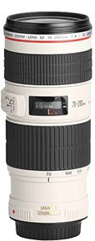
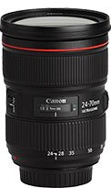
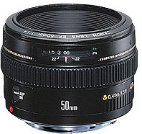
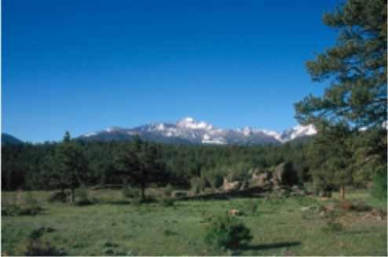
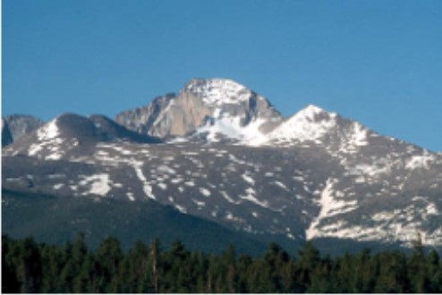
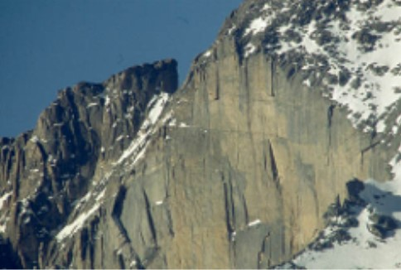
Reasoning lenses
?
?
?
Notes:
3
Think of it in terms of a camera with three lenses…Which lens is best?
Of course, that depends on what the photographer wants to see… each lens has its own value… and in each photograph, the observed object remains the same, yet the different lenses can change the way we see what we are observing through each lens.
The same thing is happening when we look at data through our different reasoning lenses. While the data remains the same, what we see is affected by the lens we use to view it.

Slide 4

Reasoning Orientations
Why do reasoning orientations matter?
How did I get
into it?
How do I get
out of it?
Problem
Notes:
4
Why do reasoning orientations matter in this work? I would like to suggest that there are two options when dealing with problems.
When facing a problem, our natural first inclination is to figure out how to get out of it… but if we want to avoid repeating our problems, we also need to figure out how we got into it.
If I drive my car into a ditch, of course the first thought is going to be “how do I get out of it?”
But if I find myself in the ditch on multiple occasions, I probably need to start understanding what are the causes that keep getting me into the ditch.
Of course, I could invest in a winch, or a subscription to a roadside assistance company, but I would be better served if I understand the causes of how I consistently end up in the ditch, instead of just becoming an expert on how to get my car out of it.
Once I understand and eliminate those causes, I can keep my car on the road where I actually want it…

Slide 5
Three common Reasoning Orientations
Solution reasoning:
Determining what immediate action to take to fix or prevent the problem
Defensive reasoning:
Determining what failed, was missed or was wrong
Causal reasoning:
Determining what actually happened that created the problem
Notes:
We have experienced several reasoning orientations in doing this work, but there are three specific ones that typically show up in investigation and performance improvement work.
First, let’s look at the definition of each, then we will talk about when they show up in problem solving.
They are Solution Reasoning, Defensive Reasoning, and Causal Reasoning
(read the definition of each)
Now that we have defined them, let’s discuss how do each one shows up in problem solving, investigation, and performance improvement

Slide 6
Reasoning Orientations
Solution reasoning:
Determining what immediate action to take to fix or prevent the problem
Reasoning Lens:
What do I need to do to fix this problem?
What action can I take based on past (assumed) causes?
How do I get
out of it?
Outcome:
An action we can take immediately based on our current understanding of the problem
Problem
Notes:
6
Back to our problem analogy…
When I get in to a problem, the first natural tendency is to get out of it.
We typically get out of a problem with an orientation called solution reasoning.
(read definition)
The lens for solution reasoning is “what action do in need to take to get out of this problem”
Based on assumed causes or causes from past experiences in a similar situation
This reasoning is most beneficial where taking action is time critical.
If I am crossing at a crosswalk where I have the right of way and see a car coming at me at high speed, do I stand there and think “What is causing this car to continue coming at me when I have the right of way?”
No, solution reasoning tells me to move out of the street immediately before I get hit. It is intuitive, and an effective way to immediately resolve my situation and get out of the immediate circumstance.
The typical outcome of Solution Reasoning is “An action we can take based on our current understanding of the problem based on our current knowledge and belief model.

Slide 7
Reasoning Orientations
Defensive reasoning:
Determining what failed, was missed or was wrong
Reasoning Lens:
What failed or was missed to cause this event?
How did I get
into it?
Outcome:
Audit findings of what should have happened instead
Problem
Notes:
7
The next two types of reasoning are typically used to describe How I got into the problem.
One of them suggests that I got into the problem by what I did, and the other by what I did not do.
When we use defensive reasoning, we look for what failed, what was missing, or we judge in hindsight what was “wrong”
Defensive reasoning is the lens of “ I got into it by what I did not do”
From a timing standpoint, it is backward looking in time, and usually triggered by hindsight bias (judging in hindsight based on knowing the outcome.)
The typical outcome of defensive reasoning is an audit finding of what should have happened instead.

Slide 8
Reasoning Orientations
Causal reasoning:
Determining what actually happened that created the problem
Reasoning Lens:
How did the event happen this way, this time?
How did I get
into it?
Outcome:
An understanding of how the individuals and the performance system worked during this event to create this specific outcome
Problem
Notes:
8
The final of the three reasoning types is also about how I got into the problem.
Causal reasoning is determining what actually happened that created the undesired outcome
My reasoning lens is from the perspective of the individuals involved, with a foresight perspective, and a learner mindset.
I suspend judgement to understand “How did it happen this way, this time?”
The typical outcome from Causal Reasoning is “An understanding of how the individuals and the performance system worked together during this event to create this specific outcome.”

Slide 9
Incident Example
Recognizing Reasoning Orientations
A flange gasket on a flow control valve in a line containing caustic liquid failed, leading to a release of the caustic material. An operator needed to take a routine water sample in the same area. He was walking past the line at the precise time that the gasket failed. The valve was mounted vertically in a line at about five feet above grade, putting it at eye level for the operator. The spray of liquid from the valve when the gasket failed struck the operator in the face. The operator was rushed to an eye wash area by a fellow worker and then taken by ambulance to the hospital afterwards. The injury was a recordable incident.
Notes:
9

Slide 10
We need to upgrade the pressure rating of the flange gaskets
The operator did not recognize the potential hazard of that valve.
The operator did not wear goggles.
What type of gasket was installed?
Causal | Defensive | Solution
The operator walked near the caustic valve wearing safety glasses.
We need to reinforce the procedures for wearing eye protection.
The operator believed it was safe to walk past the caustic valve
We need to train operators on risk recognition and abnormal situation management
Was the right gasket installed?
We need to instruct maintenance on the right gaskets for that service.
What was the operating pressure in the line?
Was the pressure in the line too high?

Slide 11
Reasoning – Key Points
Solution Reasoning
  Focuses on action to “get out of the problem”
  Actions are based on assumed causes.
Defensive Reasoning
  Triggered by hindsight bias (what it looks like after we know the outcome)
  Focused on “what they should have done differently” and “what failed or did not happen”
  Reinforces existing barriers and controls, based on what we already know or believe.
Causal Reasoning
  Uses foresight perspective (what it looked like before the outcome)
  Focused on what happened, how it happened, and why it happened
  Shifts perspective through transformational learning and allows action to address causes
Notes:
To recap the reasoning lenses:
Solution reasoning is usually focused on actions we take to get out of the problem, and reasoning is typically based on assumed causes gained from past experience
Defensive reasoning is typically triggered by hindsight bias, looking backwards in time after we know the outcome in order to judge what should have happened or what failed
It is driven by our expertise, and reinforces existing belief models of barriers and controls based on how we believe things should work. Defensive reasoning is often devoid of situational details or context, and based on what we already know or believe.
Causal Reasoning
Valuable in performance improvement investigation because performance happens in foresight, and causal reasoning is based in foresight perspective.
It focuses on what actually happened, including specifics such as time, place, and magnitude to help create systemic context for our causality.
With the context and specificity, causal reasoning stimulates learning at both an individual and system level, and allows us to create actions that work in foresight.

