Slide 1
Partners in Safety
Leadership Visits and Creating Dialogue
Using a Learner Mindset

Slide 2
partners in safety
An Introduction to Learner Mindset
A Learner Mindset is a belief that everyone can grow their ability, learn from mistakes and successes and speak up openly in a safe environment.
Some may know this as a Growth Mindset.

Slide 3
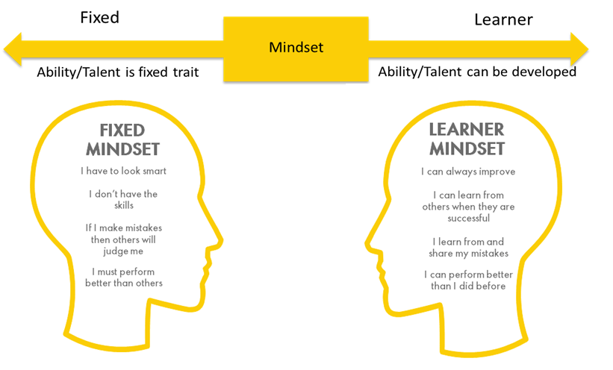
partners in safety
An Introduction to Learner Mindset
Notes:
We are all sometimes in a Fixed Mindset and sometimes in a Learner Mindset

Slide 4
partners in safety
Introduction to Learner Mindset Video

Slide 5
PARTNERS IN SAFETY
Small Group Exercise
  Themes of questions:
  How Learner Mindset shows up for me as a Leader
  How Learner Mindset shows up – or doesn’t show up – in your organization
Notes:
American English

Slide 6
PARTNERS IN SAFETY
Small Group Exercise
  Themes of questions:
  How Learner Mindset shows up for me as a Leader
  How Learner Mindset shows up – or doesn’t show up – in your organisation
Notes:
British English

Slide 7
PARTNERS IN SAFETY
Small Group Exercise
  How Learner Mindset shows up for me as a Leader
  1a) What did you learn from the last mistake or mis-judgement you made?
  1b) How do you feel that you typically show up? In a Learner Mindset or a Fixed Mindset or some of both?
  1c) When did you last find yourself outside your comfort zone? How did you show up?
  1d) What behaviors do you exhibit that encourages open conversations focused on curiosity and learning?
Notes:
American English version. Depending on time, each group could be assigned 1 question or everyone could do all the questions.

Slide 8
PARTNERS IN SAFETY
Small Group Exercise
  How Learner Mindset shows up for me as a Leader
  1a) What did you learn from the last mistake or mis-judgement you made?
  1b) How do you feel that you typically show up? In a Learner Mindset or a Fixed Mindset or some of both?
  1c) When did you last find yourself outside your comfort zone? How did you show up?
  1d) What behaviours do you exhibit that encourages open conversations focused on curiosity and learning?
Notes:
British English version. Depending on time, each group could be assigned 1 question or everyone could do all the questions.

Slide 9
PARTNERS IN SAFETY
Small Group Exercise
  How Learner Mindset shows up – or doesn’t show up – in your organization
  2a) What will it take for you to lead the change to adopt more of a Learner Mindset approach in your organization?
  2b) How do you operationalize the concept(s) of Learner Mindset into the day to day works of your organization?
  2c) How do you encourage people to admit mistakes and share dilemmas they face?
  2d) What behaviors would you like to see in your organization where people will start to show up with a more consistent Learner Mindset?
Notes:
American English. If you just had one question on the previous slide, use the same lettered question this time.

Slide 10
PARTNERS IN SAFETY
Small Group Exercise
  How Learner Mindset shows up – or doesn’t show up – in your organisation
  2a) What will it take for you to lead the change to adopt more of a Learner Mindset approach in your organisation?
  2b) How do you operationalise the concept(s) of Learner Mindset into the day to day works of your organisation?
  2c) How do you encourage people to admit mistakes and share dilemmas they face?
  2d) What behaviours would you like to see in your organisation where people will start to show up with a more consistent Learner Mindset?
Notes:
British English. If you just had one question on the previous slide, use the same lettered question this time.

Slide 11
partners in safety
Learner Mindset – Plenary Conversation
Notes:
Come back together as a large group and discuss your findings.

Slide 12
Maritime partners in safety
Learner Mindset in Practice Video

Slide 13
PARTNERS IN SAFETY
Reflection
Each person to individually reflect on and write down:
  What have I learnt when thinking about being in a Learner Mindset?
  How can I be a more curious leader?
  What am I doing to promote those around be speaking up? Do I make it safe for them to tell me bad news?
  How can I promote my vision of a legacy by using the Learner Mindset tool?
Notes:
Depending on the group, you could share your reflections.

Slide 14
Thank You

